Slide 1




Colonial Pipeline Ransomware
A Landmark Case of Critical Infrastructure Vulnerability
TOPIC
CASE YEAR
IMPACT
Infrastructure Security
2021
45% U.S. East Coast Fuel

Slide 2
1. The National Crisis
When a single password paralyzed the American East Coast

Slide 3
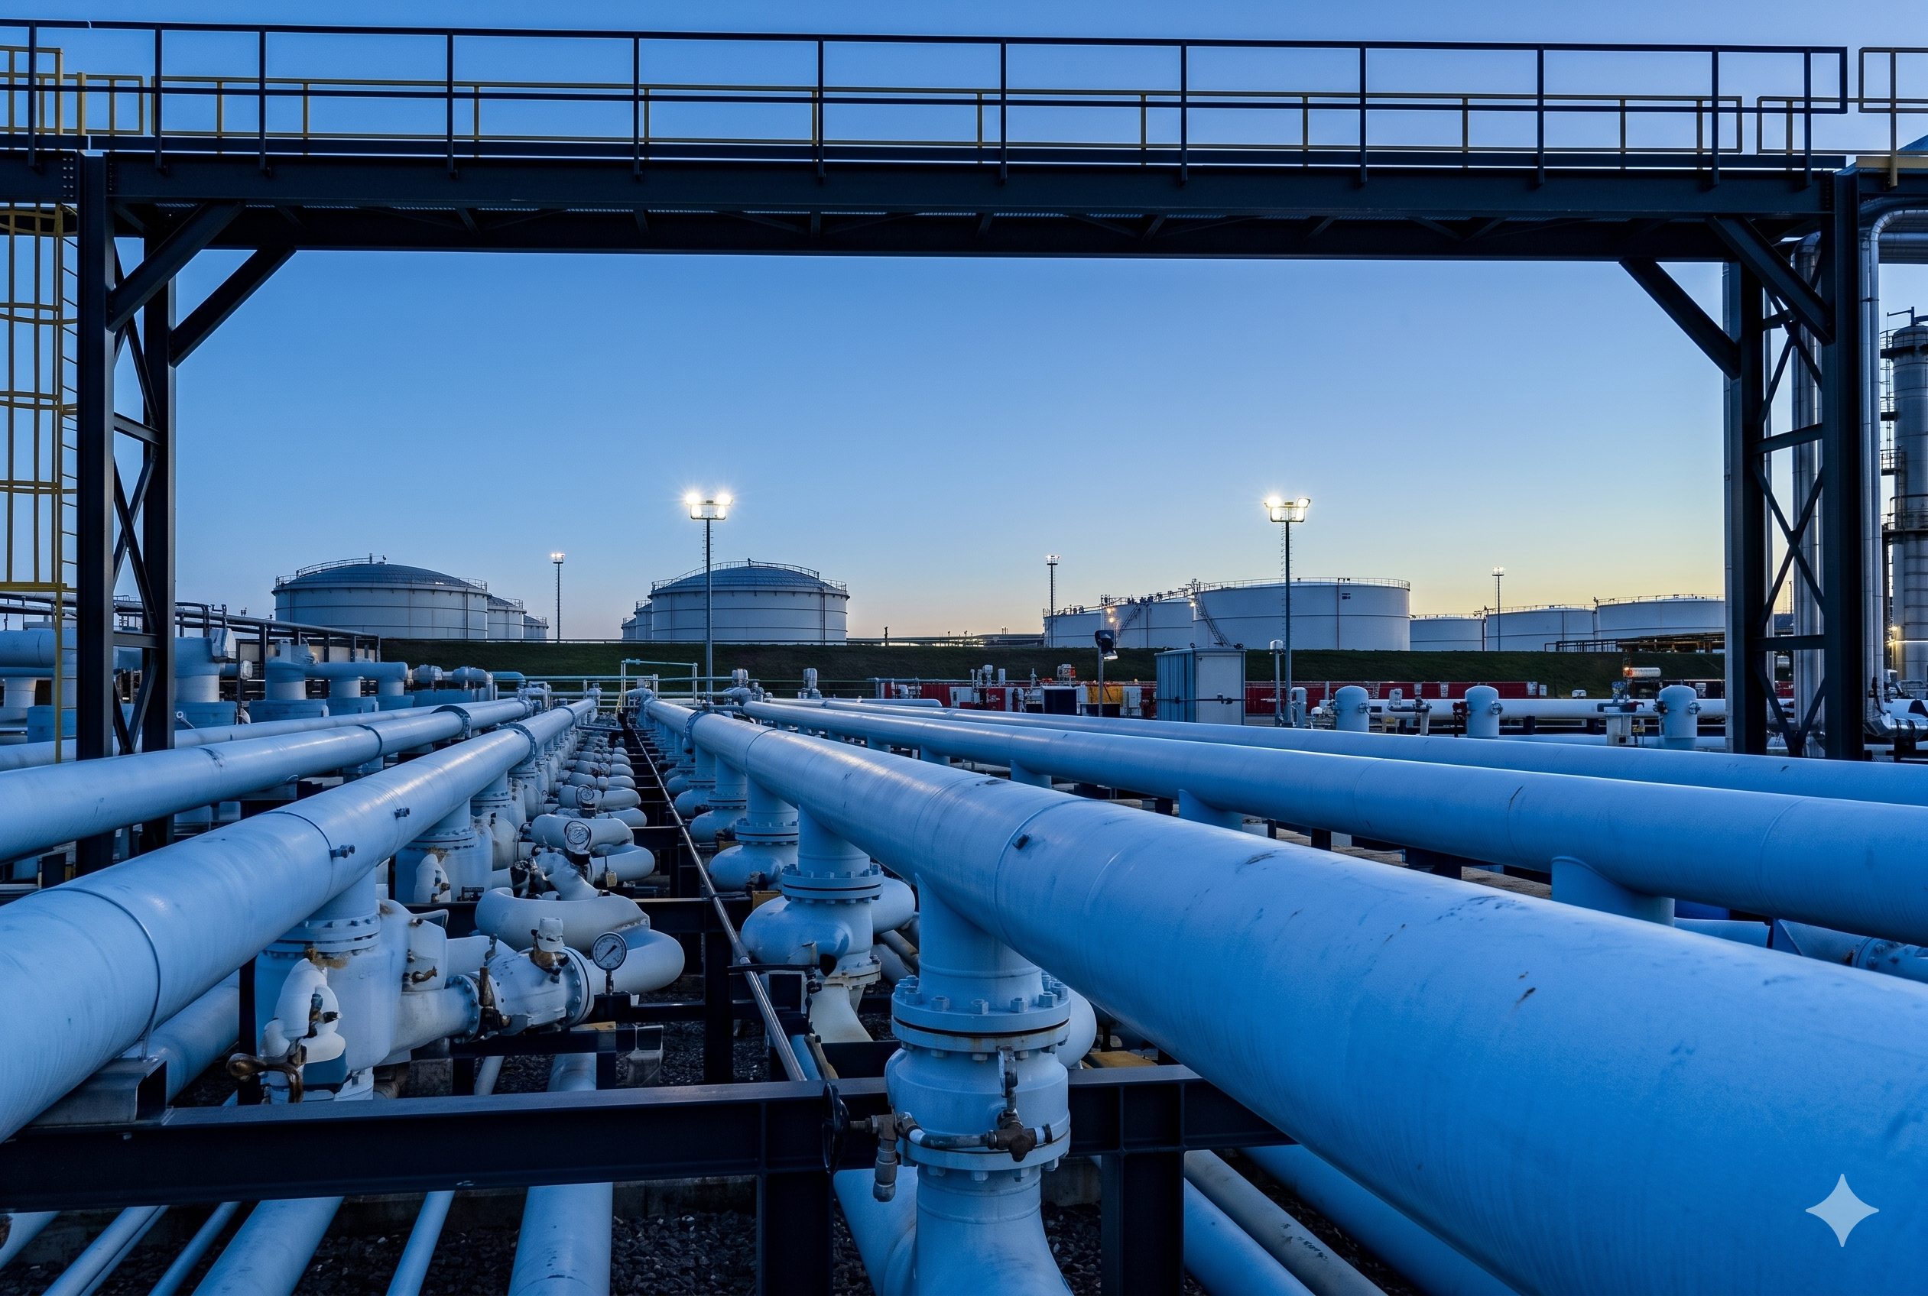
The Initial Breach
The "Entryway" Failure
On May 7, 2021, employees discovered a ransom note on a background of their system. The attackers didn't need zero-day exploits.
•
Vector: Compromised VPN credentials from an unused, legacy account.
•
Fatal Flaw: Lack of Multi-Factor Authentication (MFA).
•
Proactive Action: Colonial shut down the 5,500-mile pipeline to prevent ransomware from jumping from IT to OT (Operational Technology) networks.

Slide 4


Systemic Vulnerabilities
Legacy Debt
IT/OT Convergence
The company relied on an inactive VPN account that was not decommissioned. This "zombie" credential provided a persistent tunnel for attackers to move laterally.
While the actual pipeline controls weren't infected, the billing system was. Without it, Colonial couldn't track fuel flow or charge customers, forcing a full operational halt.

Slide 5
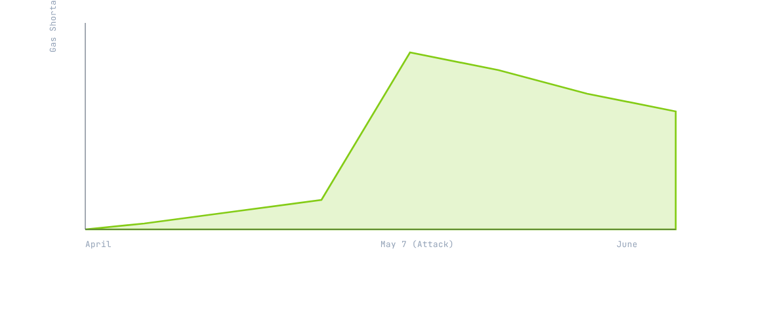
Economic Disruption Trend
Fuel scarcity peaked 4 days post-attack as panic buying drained 90% of stations in major hubs like Charlotte, NC.

Slide 6








STRIDE Threat Analysis
Spoofing
Tampering
Info Disclosure
Denial of Service
Attackers utilized valid, compromised VPN credentials to impersonate a legitimate remote employee.
Deployment of encryption payloads across IT servers, rendering billing and business data inaccessible.
100GB of sensitive corporate data was exfiltrated for "double extortion" purposes prior to encryption.
The core business objective was halted by encrypting the systems required to manage pipeline logistics.

Slide 7
The 6-Day Crisis Timeline
May 7
Ransomware discovered; Pipeline shut down proactively.
May 13
System restart initiated; National emergency lifted.
April 29
May 10
Initial breach via compromised VPN credentials.
FBI identifies DarkSide; $4.4M ransom paid in BTC.

Slide 8
Impact by the Numbers
Catastrophic Fallout
The shutdown triggered the most significant energy crisis in the digital age.
17
•
$4.4 Million: Ransom paid within hours to receive a (slow) decryption tool.
U.S. States in Emergency
•
2.5 Million: Barrels of fuel disrupted daily.
•
$2.3 Billion: Estimated total economic damage from supply chain delays.

Slide 9
Security Policy Evolution
Category | Pre-2021 Posture | Post-Attack Requirement
Access Control | Single-factor, static passwords | Mandatory Multi-Factor (MFA)
Segmentation | Interconnected IT and OT logs | Air-gapped billing vs control
Reporting | Voluntary disclosure | TSA Mandatory 24h reporting
Crisis Plans | Ad-hoc recovery | Required Cyber Incident Drills

Slide 10

DarkSide RaaS
The attack was orchestrated by DarkSide, a Russia-based Ransomware-as-a-Service (RaaS) group.
Unlike state-sponsored spies, they operated like a business, offering "customer support" to victims and maintaining a "code of ethics" (e.g., avoiding hospitals).
"Our goal is to make money, and not creating problems for society." — DarkSide Press Release

Slide 11
"I made the decision to pay, and I made the decision to keep it as quiet as possible... It was the right thing to do for the country."
— Joseph Blount, CEO of Colonial Pipeline

Slide 12
Thank you for your attention.

Slide 13


Image Sources
https://www.colpipe.com/wp-content/uploads/2024/11/homepage-hero.jpg
Source: www.colpipe.com
https://istari-global.com/assets/Uploads/A-Closer-Look-at-the-DarkSide-Ransomware-Gang-v2__ScaleMaxWidthWzEwMDBd.png
Source: istari-global.com

